Slide 1

College code : 5113
BATCH MEMBERS :
1. Bhavya . S (511321104012) bhavyasubramanyam2004@gmail.com
2. Dayana . S (511321104015) ushaday21@gmail.com
3.deepthi charishma . P (511321104018) deepthicharishma31@gmail.com
4. kavya Priya . S (511321104043) kavyapriya302@gmail.com

Slide 2
DATA ANALYTICS with cognos
Air quality analysis in
tamilnadu

Slide 3
Project Definition:
The project aims to analyze and visualize air quality data from monitoring stations in Tamil Nadu. The objective is to gain insights into air pollution trends, identify areas with high pollution levels, and develop a predictive model to estimate RSPM/PM10 levels based on SO2 and NO2 levels. This project involves defining objectives, designing the analysis approach, selecting visualization techniques, and creating a predictive model using Python and relevant libraries.

Slide 4
OBJECTIVES :
Analysing air quality trends :
Parameters :
Particulate Matter (PM2.5 and PM10): Tiny particles that can enter the lungs.
Nitrogen Dioxide (NO2): A gas produced by combustion processes.
Sulfur Dioxide (SO2): A gas primarily released from burning fossil fuels.
Ozone (O3): A secondary pollutant formed by chemical reactions.
Carbon Monoxide (CO): A product of incomplete combustion.
Air Quality Index (AQI): A composite index representing overall air quality.

Slide 5
Spatial analysis :
Analyze air quality data for different regions within Tamil Nadu. Certain areas may have higher pollution levels due to industrial zones, traffic congestion, or other factors.
Meteorological factors:
Examine meteorological data alongside air quality data to understand how weather conditions (e.g., temperature, wind speed, precipitation) influence air quality.
Identify Pollution Sources:
Investigate major sources of air pollution in Tamil Nadu, such as industries, transportation, construction, and agricultural practices.Evaluate the impact of government policies and regulations on pollution reduction.

Slide 6
Pollution Hotspots of TamilNadu :
Chennai
Thoothukudi
Cuddalore
Mettur
Coimbatore
Vellore
Tiruppur
Sivakasi
Neyveli
Erode

Slide 7
Predictive model for RSPM/PM10 levels :
Step 1: Data Collection
Step 2: Data Preprocessing
Step 3: Feature Selection/Engineering
Step 4: Model Selection
Step 5: Model Training
Step 6: Model Evaluation
Step 7: Hyperparameter Tuning
Step 8: Model Interpretability
Step 9: Deployment and Monitoring
Step 10: Communicate Results

Slide 8
Analysis approach :
steps to load, preprocess, analyze, and visualize the air quality data :
Step 1: Data Acquisition
Step 2: Data Cleaning and Inspection
Step 3: Data Preprocessing
Step 4: Exploratory Data Analysis (EDA)
Step 5: Data Analysis
Step 6: Data Visualization
Step 7: Interpretation and Insights
Step 8: Reporting and Documentation
Step 9: Continuous Monitoring and Updating
Step 10: Communication

Slide 9
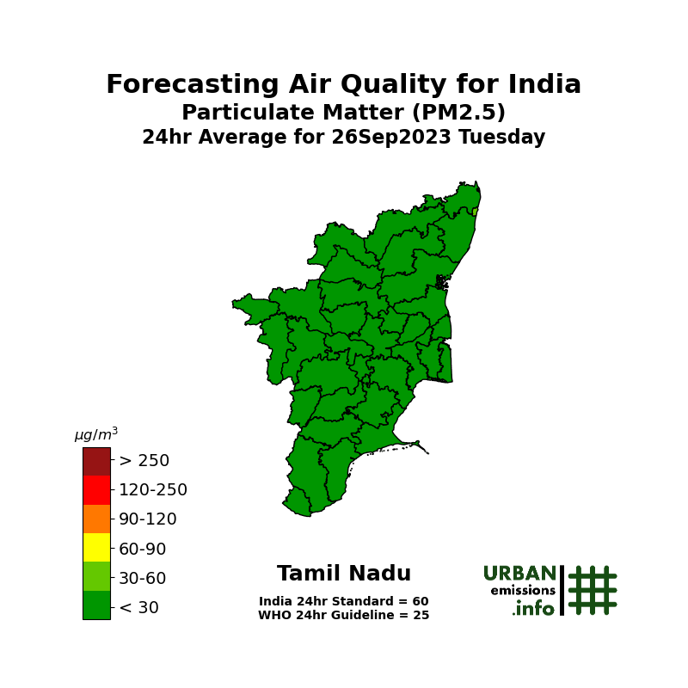
Visualization Selection : HEAT MAP :

Slide 10
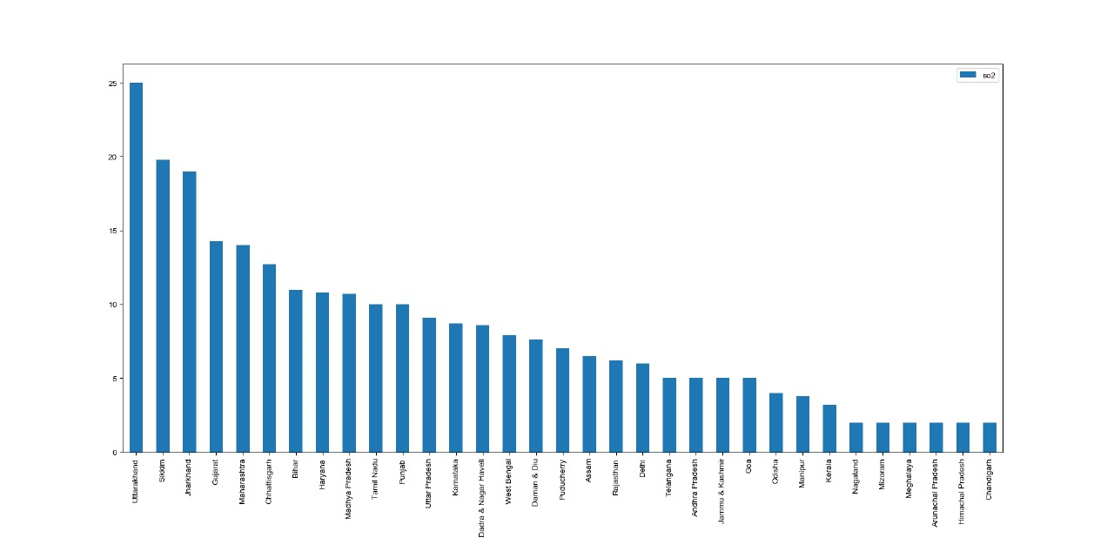
BAR CHARTS :

Slide 11
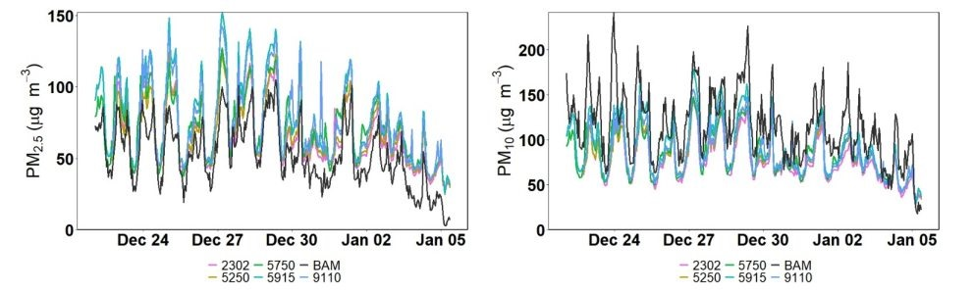
TIME SERIES PLOTS :

Slide 12
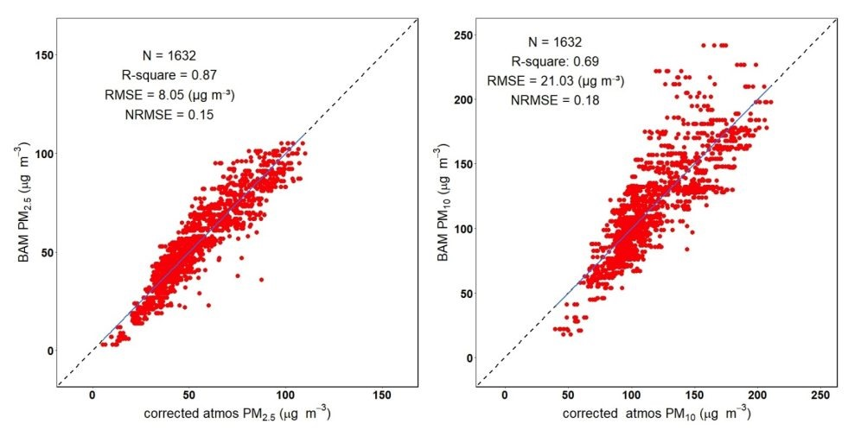
SCATTER PLOTS :

